Slide 1
Artificial Intelligence
Chapter 5: Adversarial Search
In which we examine the problems that arise when we try to plan ahead in a world
where other agents are planning against us.
Instructor: Zakariya Ahmed Oraibi
University of Basrah, Iraq

Slide 2
Adversarial Search
Games are competitive environments where agents’ goals are in conflict.
In this chapter, we will focus on zero-sum games. Such as chess.
This means, deterministic, fully observable environments in which two
agents act alternately. For example, if one player wins a game of chess, the
other player necessarily loses. It is this opposition between the agents’ utility
functions that makes the situation adversarial.
Adversarial Search also referred to as Games.
In chess, we plan ahead and the other agent is planning against us.

Slide 3
Adversarial Search
The state of a game is easy to represent, and agents are usually restricted to a small number of actions whose outcomes are defined by precise rules.
Physical games, such as ice hockey, have much more complicated descriptions, a much larger range of possible actions, and rather imprecise rules defining the legality of actions..
Why it’s interesting to study Games?
In chess, the search tree has about 35¹⁰⁰ or 10¹⁵⁴ nodes.
Games are like real world problems, they require decisions to be made.

Slide 4
Adversarial Search
Assumptions:
Two agents whose actions alternate.
Fully observable environment.
Difference between Search and Adversary:
In adversary (games) we use strategy, while in search we use heuristic.
In games, optimality depends on opponents.
In search, the evaluation function involves estimating the cost from start to end.

Slide 5
Adversarial Search
Example: Game Setup
Two players: Max and Min.
Max moves first and they take turn until game is over.
Game as Search
Initial state: e.g. board configuration of the chess.
Successor function: list of (move, state) pairs – legal moves.
Terminal test: is the game finished?
Utility function: +1 (winner), -1 looser.

Slide 6
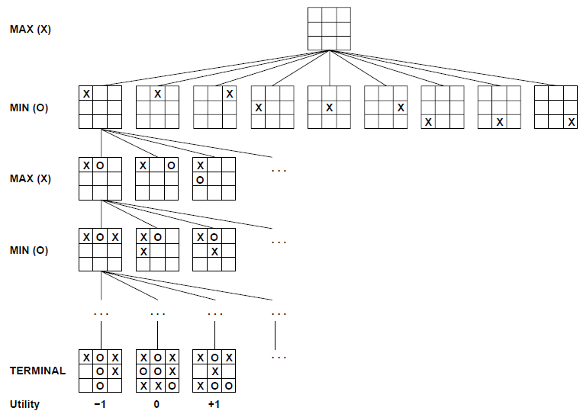
Adversarial Search
tic-tac-toe game tree
Minmax Strategy:
Max wants to Maximize the utility function. While, Min wants to Minimize it.
Complete Depth-First Search of the game tree.
Assumption: Both players play optimally.

Slide 7
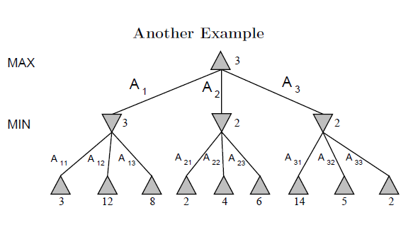
Adversarial Search
Max Nodes Δ
Δ
Min Nodes
What are the values for Max and Min nodes?

Slide 8
Adversarial Search
Max Nodes Δ
Δ
Min Nodes
3
What are the values for Max and Min nodes?

Slide 9
Adversarial Search
Max Nodes Δ
Δ
Min Nodes
3
2
What are the values for Max and Min nodes?

Slide 10
Adversarial Search
Max Nodes Δ
Δ
Min Nodes
3
2
2
What are the values for Max and Min nodes?

Slide 11
Adversarial Search
Max Nodes Δ
3
Δ
Min Nodes
3
2
2
What are the values for Max and Min nodes?

Slide 12
Adversarial Search
Max Nodes Δ
A₁
Min Nodes
A₁₁
A₁ is the best choice for Max
A₁₁ is the best choice for Min

Slide 13
Adversarial Search
Problems with MinMax Search:
* Number of states is exponential
Solution:
Don’t examine every node.
Use Pruning.
Remove branches that don’t influence the final decision.

Slide 14
Adversarial Search
Alpha-Beta Algorithm:
Depth-first search only considers nodes along a single path.
α = highest value choice that we can guarantee for MAX.
β = lowest value choice that we can guarantee for MIN.
Update values for both α and β during search and prune remaining branches as soon as the value is known to be worse than current α and β for both MAX and MIN.

Slide 15
Adversarial Search: Alpha-Beta Algorithm
Example: [Max = -∞ , Min = +∞]
Which branches will be pruned?

Slide 16
Adversarial Search: Alpha-Beta Algorithm
Example: [Max = -∞ , Min = +∞]
Which branches will be pruned?

Slide 17
Adversarial Search: Alpha-Beta Algorithm
Example: [Max = -∞ , Min = +∞]
Which branches will be pruned?

Slide 18
Adversarial Search: Alpha-Beta Algorithm
Example: [Max = -∞ , Min = +∞]
Which branches will be pruned?

Slide 19
Adversarial Search: Alpha-Beta Algorithm
Example: [Max = -∞ , Min = +∞]
Which branches will be pruned?

Slide 20
Adversarial Search: Alpha-Beta Algorithm
Example: [Max = -∞ , Min = +∞]
Which branches will be pruned?

Slide 21
Thank You

